Slide 1
ICArUS Pilot Study 1: Facility Identification
Matt Caywood, Brandon Beltz, Michael Fine
April 21, 2011
Distribution restriction:
Information in this document, in whole or in part, cannot be released outside of the ICArUS Program without the prior written permission of the ICArUS Program Manager and Contracting Officer.

Slide 2
Goals
The ICArUS Program will employ a GEOINT-themed Challenge Problem to compare the models’ performance with human performance. This study is designed to address a number of open questions related to the design of the Challenge Problem. In particular,
Can people learn to recognize patterns/select a frame in a high-dimensional feature space?
What types of training – statistical learning, rules etc. - facilitate such learning?

Slide 3
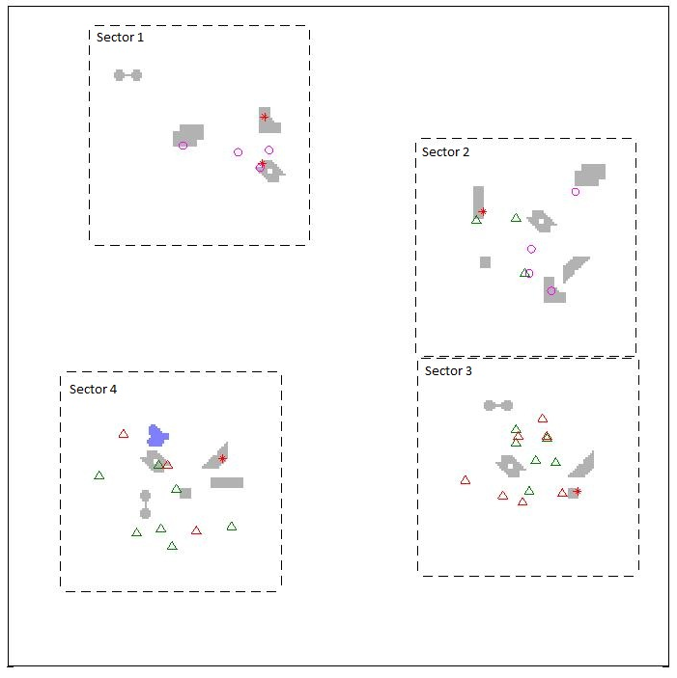
Methods: Facilities
Participants were asked to identify 4 fictitious facilities (Ketchup-, Mustard-, Salt- and Pepper-producing Factories); 2-4 facilities appeared simultaneously in the scene. A facility was comprised of data from multiple layers.
A scene with 4 facilities.

Slide 4
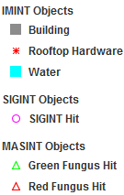
Methods: Data
Three categories of data were associated with the task (IMINT, SIGINT, and MASINT).
IMINT (Image Intelligence): the location and shape of a building, water features, and the presence or absence of rooftop hardware, e.g., a satellite dish.
SIGINT (Signals Intelligence): intelligence gathered by the interception of signals; each ‘hit’ denotes an intercepted signal at that location (e.g., a government-issued cell phone).
MASINT (Measurement and Signature Intelligence): chemical intelligence; each ‘hit’ denotes that a chemical (e.g., green or red fungus) has been detected at that location.

Slide 5
Methods: Questions
Data was presented:
simultaneously (all at once)
sequentially (one layer at a time)
or sequentially based on user choice (participants were given a choice of which data to see next).

Slide 6
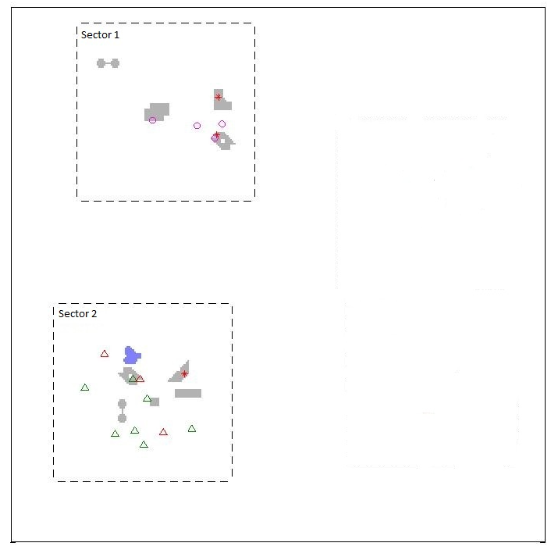
Methods: Questions
The test comprised of a series of multiple-choice questions, and all responses were in the form of likelihoods (e.g., the probability that a particular sector contained a facility). Participants were asked to either:
1. Locate a facility in the scene
2. Identify a facility in a sector
Example scene

Slide 7
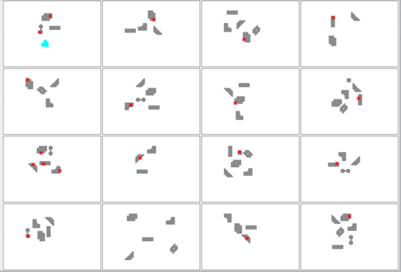
Methods: Training
Participants were trained via statistical learning (partially-annotated examples of each facility) or rules.
Annotation: 48 examples of each facility were presented, 16 at a time.
Training via example (16 instances of a Ketchup Factory shown; IMINT only).

Slide 8
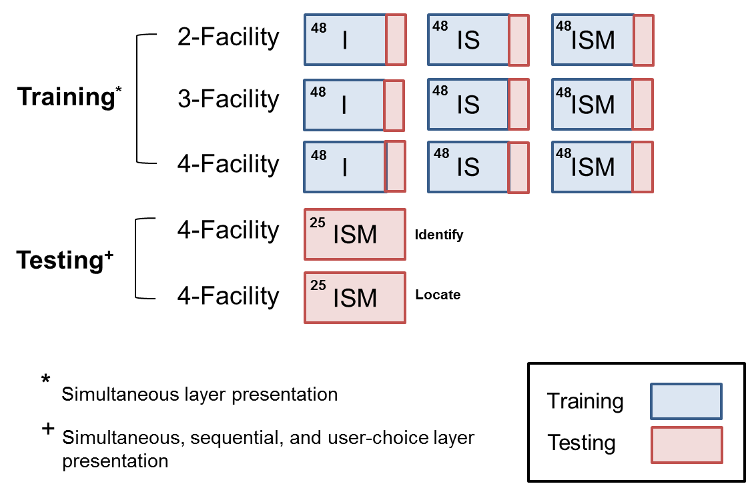
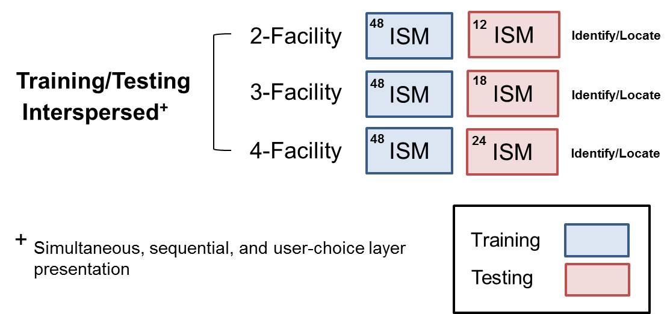
Methods: Structure
Experiment 1
Experiment 2 (Not yet run)
Exp. 1 was divided into 2 sections: training and testing. The number of training examples (training) or questions (testing) is given in the upper-left corner of each box.
In Exp. 2 (not yet run), training and testing were interspersed.

Slide 9
Results: Overview
What was analyzed
Metrics
Subject performance
Subject conservatism
Subject reports
Future analyses

Slide 10
What was analyzed?
Data from 11 subjects (3 team members were also run)
Two final test phases (50 questions)
Identify and Locate questions
Final answer to all question types (Simultaneous, Sequential and User Choice)

Slide 11
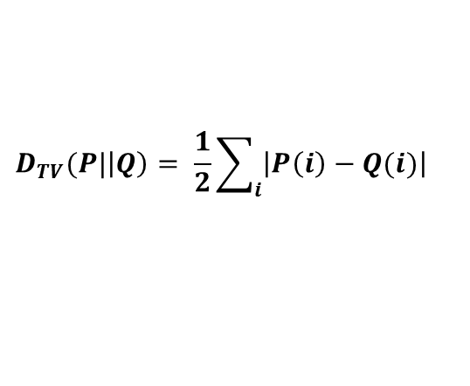
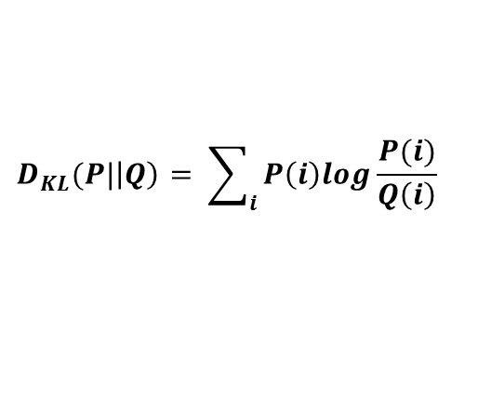
Metrics for comparing probability distributions (normative, human, random)
Winner-take-all
Did subject pick most probable facility/sector?
0 when probability distributions have same peak; 1 otherwise
KLD (Kullback-Leibler divergence):
Nonlinear divergence between normative and subject probability distributions
In BAA; information theoretic measure
TVD (total variation distance):
Absolute value distance between normative and subject probability distributions
Potentially more robust to response biases
$$D_{KL}(P|\left|Q\right)= \sum_{i}{P\left(i\right)log\frac{P(i)}{Q\left(i\right)}}$$
$$D_{TV}(P|\left|Q\right)= \frac{1}{2}\sum_{i}{\left|P\left(i\right)−Q(i)\right|}$$

Slide 12
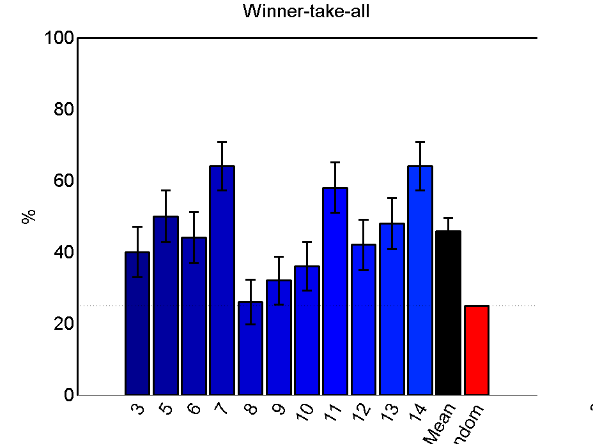
Subjects could learn to recognize patterns All subjects identified correct facility at above-random rates. 3 of 11 got nearly 60% of facilities correct
error bars SEM
Mean
Random
Subject

Slide 13
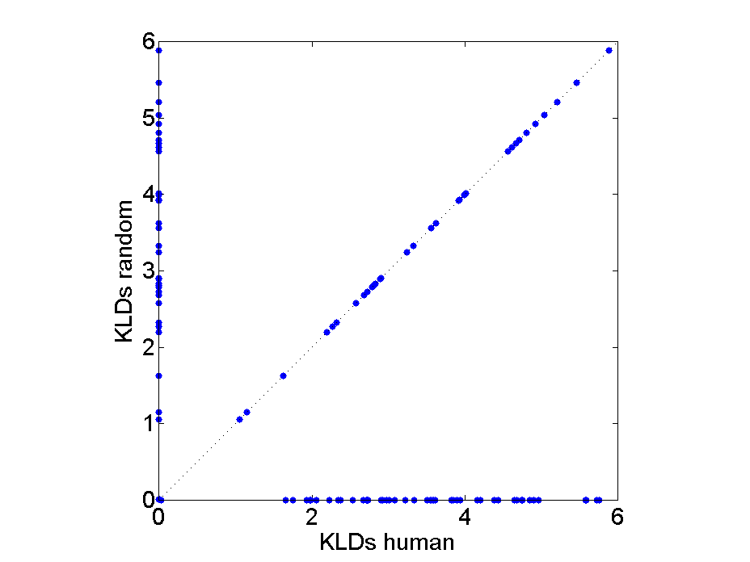
Evaluating subject performance using KLD/TVD metrics (as in BAA)
Normative
We compare
Human divergence from normative, to
Random model divergence from normative
Above/left of diagonal → subject exceeds random performance
Each point = 1 question
A
B
C
D
Random
Perfect
A
B
C
D
A
B
C
D
Wrong
A
B
C
D

Slide 14
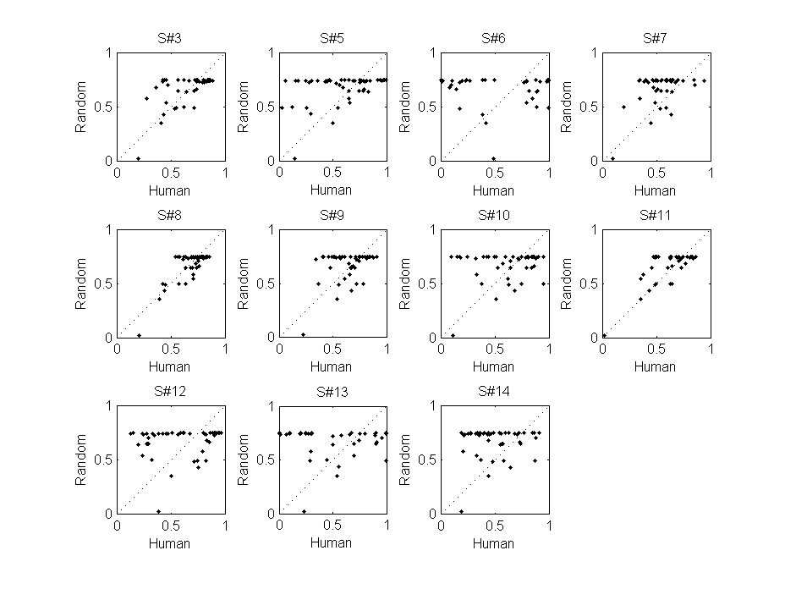
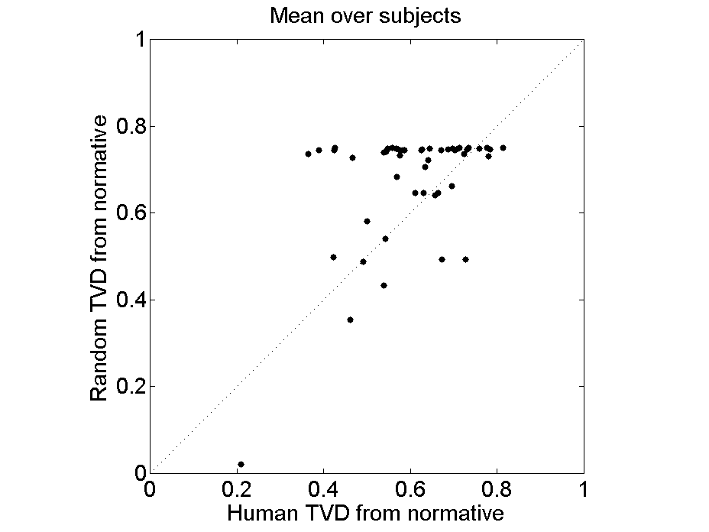
Subject group learned (by TVD analysis)
Performance better than random with p < 0.0001 (n = 50)

Slide 15
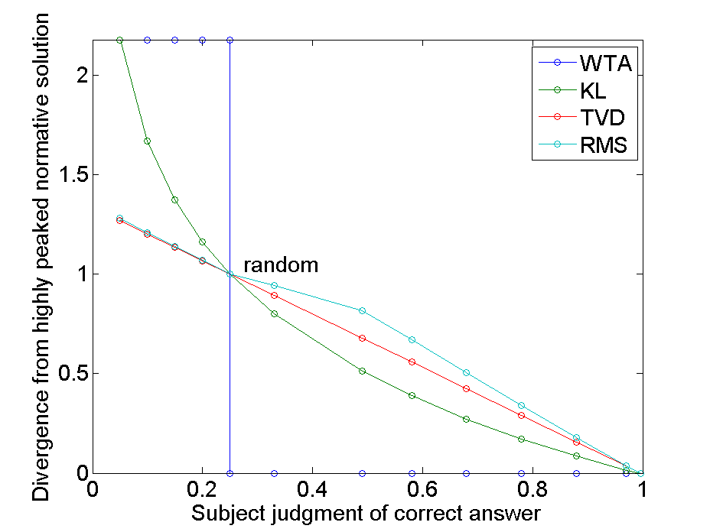
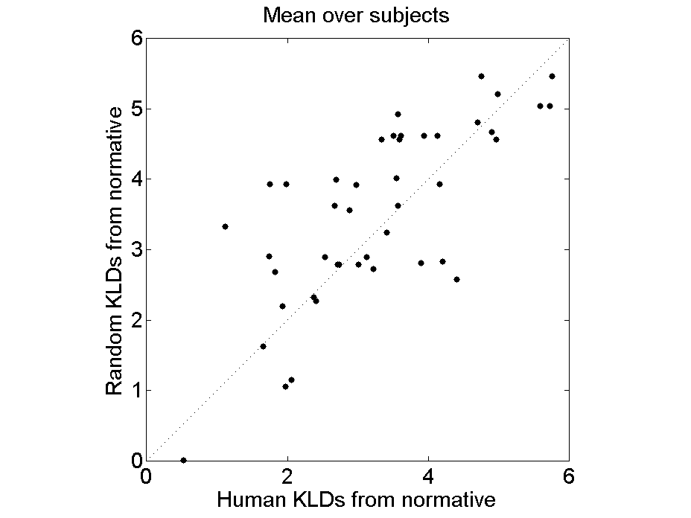
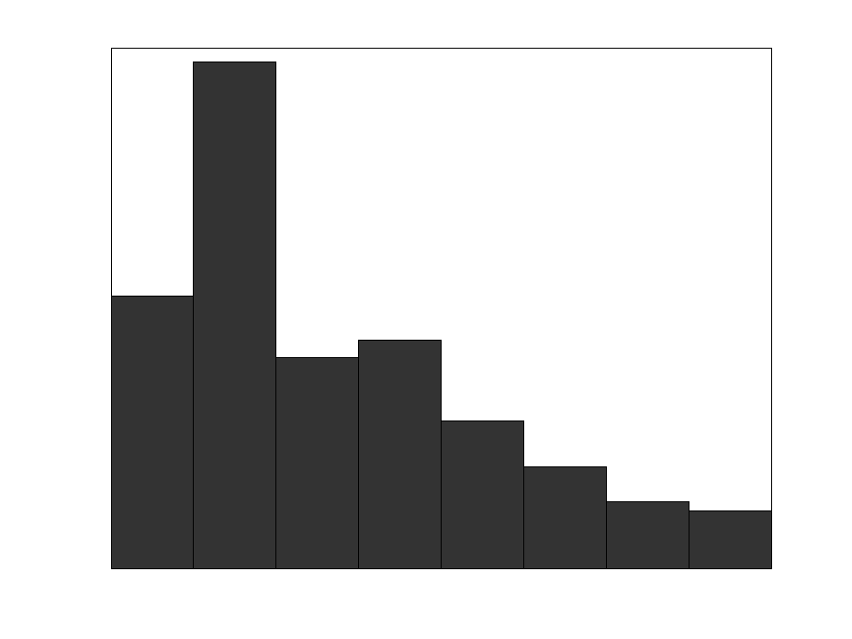
KLD did not show learning
Problems with KLD in pilot study
Subject mistakes are greatly exaggerated ( )
Problem worse when solutions very peaked (as they were in pilot study)
KLD
mistaken
underconfident
correct
Observed subject judgments in pilot study

Slide 16
Subject confidence
Subjects were able to form concepts of facilities leading to correct facility identifications
Some subjects were underconfident/conservative in their responses
Some subjects did not learn probabilities effectively
Some did not feel confident about giving answers
Some may have been biased by UI
At least one believed that answers were ~80/20 on account of test asking about probabilities
Some had problems with probability elicitation/UI
Several subjects reported that they did not think “probabilistically” and that reporting their answers in percentages was challenging
Some subjects may have ignored the effects of normalization on final judgment, e.g. adjusting the sliders to give rank order corresponding to the ‘most probable’ facility
Most subjects moved probability sliders less than optimal amount (See example on next slide)

Slide 17
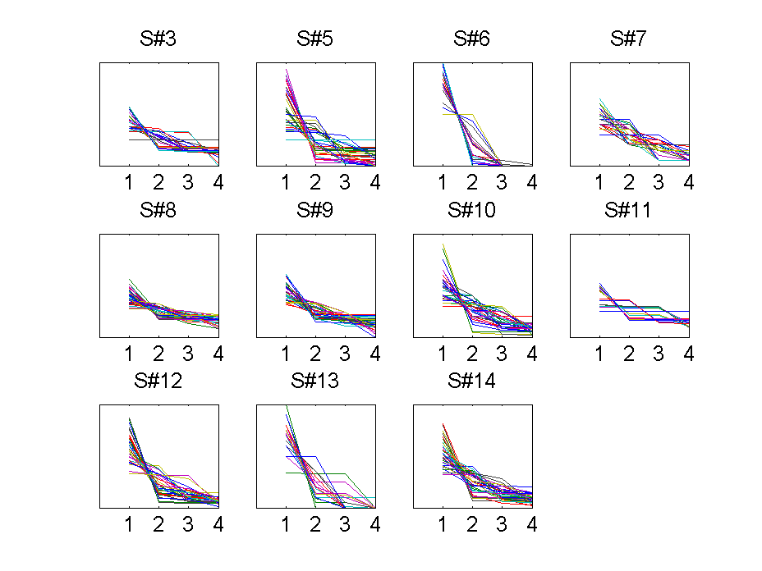
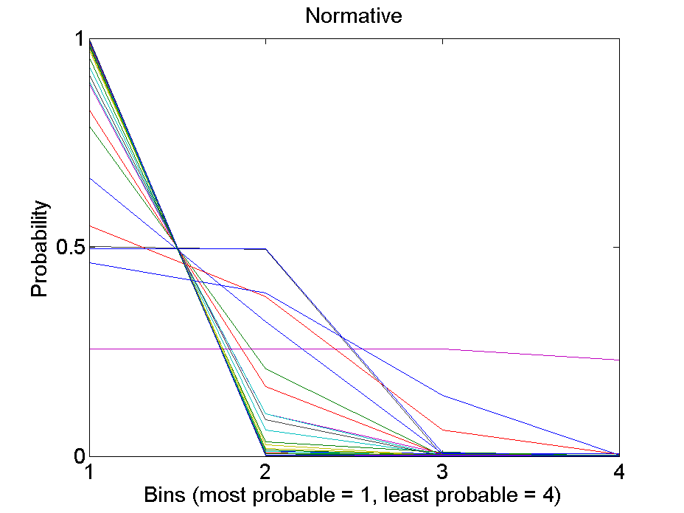
Subject judgments were conservative relative to normative solution
Rank-order probability curves
3
2
4
1
1
2
3
4
1
2
3
4
A
B
C
D
1 line = 1 trial

Slide 18
What types of training supported learning?
Statistical learning seemed to help subjects focus on rules
Subjects reported using about 3-5 different rules or strategies to identify facilities.
e.g. “If red and green triangles, then mustard. Circles plus no water, then ketchup. Plus others I can't remember.”
e.g. “The chemicals were the most consistent. none = ketchup, both = mustard, green = salt, red = pepper”
For rule learning, memory limits were a big issue!
All subjects reported that they forgot some of the rules they developed over the course of the experiment.
Several reported that it was very difficult to learn the facilities due to the lack of feedback.

Slide 19
Subject feedback: Opinions about the overall study
Question | Average Response (Scale)*
1. I think the study instructions were easy to understand. | 3.4
2. I think the study test questions were easy to understand. | 3.6
3. I think the study test questions were easy to answer. | 2.4
4. I think it was easy to use the computer software during the study. | 3.6
5. I think it was easy to input my answers using the probability sliders in the study. | 3.0
6. I felt like I was engaged or having fun during the study. | 2.2
7. I felt like I was interested in the study. | 2.9
8. I felt bored throughout the study. | 2.4
9. I felt tired throughout the study. | 3.3
*Response Scale
Strongly Disagree (1) | Disagree (2) | Neutral (3) | Agree (4) | Strongly Agree (5)
Notes:
Some subjects did select the “strongly” options (1 or 5) on some questions so the entire scale was used.
No statistical power or confidence to these numbers. They are simply rough guidelines as to what direction subjects were leaning in their opinions.
Subjects usually did not feel engaged or like they were having fun.
Test questions were easy to understand…not so easy to answer
Computer software and sliders were slightly positive and neutral respectively
Subjects felt slightly tired, but not overly bored

Slide 20
Future analyses
Specific facility identification
Were subjects better at identifying facilities they trained on earlier?
Was performance predicted by training time?
Learning of specific scene features / INTs
Data from assessment questions
Was performance predicted by training time on INTs?
Question difficulty
Facilities more or less typical of category
One peaked answer vs. multiple valid answers
Question type analyses
Did answers in sequential questions approach normative?
Were subject INT choices optimal?
Did subjects respond similarly to same scene queried with different question types?

Slide 21
Backup

Slide 22
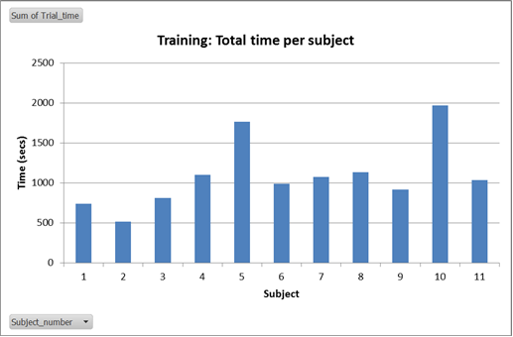
Subjects attended to training over time
Average time spent training: 18 min (range 8.5 – 33 min)
Subjects sped up (time per phase) through training

Slide 23
Experiment 1: Detailed Structure
Experiment 1, Testing (Set 19 and 20)
Defined next slide…

Slide 24
Structure Key
Question {Identify, Locate}
The type of question.
Target {A, B, C, D}
The target facility (Identify/Locate Facility A).
Presentation {Simultaneous, Sequential, Choice}
The data was presented ‘simultaneously’ (all at once), ‘sequentially’ (one layer at a time), or ‘sequentially based on user choice’ (participants were asked which layer they would like to see next).
Order
Simultaneous {ISM}
IMINT (I), SIGINT (S), and MASINT (M) were presented simultaneously.
Sequential {I-S-M, I-M-S}
Choice {I-SM}
IMINT was presented first. Users could choose to see SIGINT or MASINT.
Scene {1-16}
Scene number. Multiple questions were asked per scene.

